Slide 1

Hotel Booking
DEPI (Data Analytics Power BI Final Project)

Slide 2
Group Code: ALX2_DAT2_G3 Team Members: Rehab Ahmed Hassen REHAM MOHAMED IBRAHIM

Slide 3
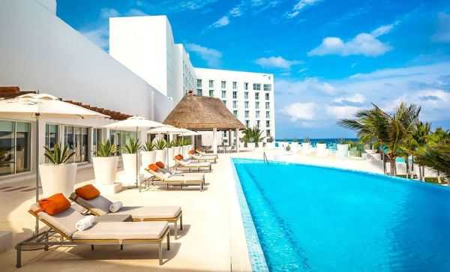
Introduction:
The hotel industry is a vital part of the global economy, providing accommodation, services, and experiences to travelers for leisure and business purposes. As a customer-focused sector, hotels rely on data analysis to understand guest behavior, optimize operations, and enhance decision-making. By analyzing booking data, businesses can improve revenue strategies, identify trends, and deliver tailored services in this competitive and dynamic industry.

Slide 4

Main Objective of this Project:
Provide a comprehensive overview of hotel booking performance, identify key factors influencing booking patterns and cancellation generation, and enable data-driven decision-making to optimize operations and reduce cancellations for both the City Hotel and Resort Hotel properties

Slide 5

Steps:
Data Import into Power BI
Data inspection and cleaning
The dataset is a single CSV file.
It contains hotel booking information (119390 observations) for a City hotel and a Resort hotel between the 1st of July 2015 and the 31st of August 2017 .
Each observation represents a distinct hotel booking (by phone number).
Including booking details, customer information, and reservation status. (119390 rows, 36 columns)

Slide 6
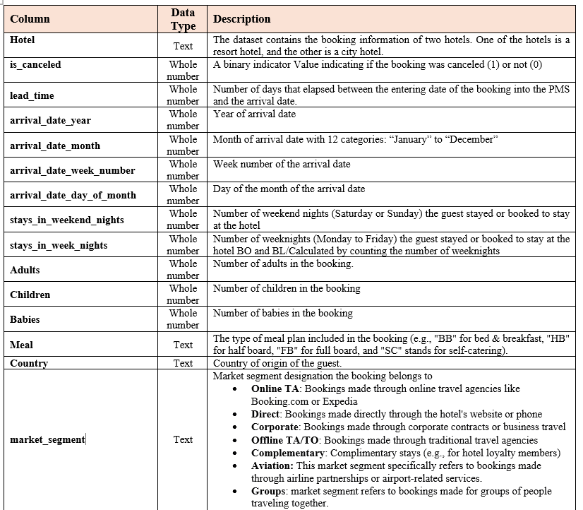

Slide 7
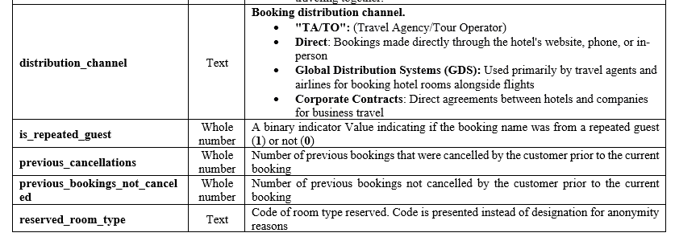

Slide 8
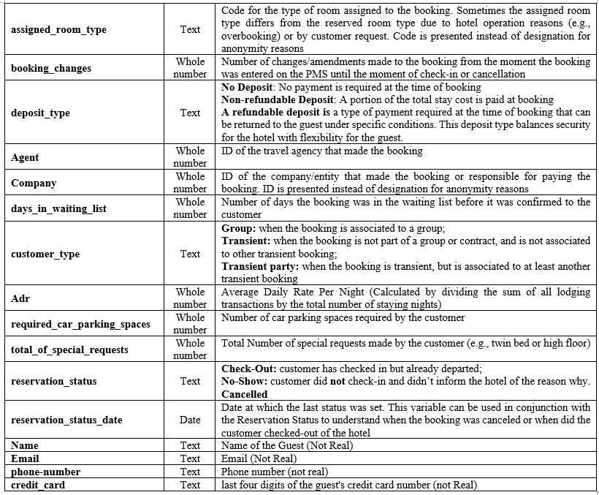

Slide 9

Data cleaning :
Check data types: Ensure correct data types for all columns.
Exclude any duplicates.
Handle missing values
The country column: replace null values by Unknown; else, same values of country column
The agent and company columns: replace missing values by number 0.
Merge arrival_date_month, arrival_date_day_of_month, and arrival_date_year in single column and renamed arrival date. Change data type to (date).
Correct reservation status date in Power query by new conditional column:
Correction of reservation status for:
Check-Out guests with zero nights of stay to Day-Use
No-Show guest with arrival date<> reservation status date
In DAX, new column.

Slide 10
Challenges in this data:
Data Granularity: The level of detail in the data will impact the types of analysis performed, for example:
The "Total Available Rooms" & “customer satisfaction scores “ are not available in this data.
Data Completeness: Missing data can bias results. In this data:
In the country attribute: 488 missing values.
In the agent attribute, 16340 values are missing.
In the company attribute: 112593 missing values.
In the children attribute: 4 missing values.
Data inconsistency:
Inconsistent reservation status date for number of Check-Out guests.
Inconsistent reservation status for a single No-Show guest.
Inconsistent reservation status for several Check-Out guests with zero nights of stay. (representing Day-Use guests).
Inconsistent some values of the is-repeated-guest column (recorded as 0) for several guests with previous bookings.
External Factors: may influence hotel performance (e.g., seasonality, economic conditions, local events).
Segmentation: Analyze KPIs across different segments of customers, and booking channels to identify opportunities for optimization.

Slide 11
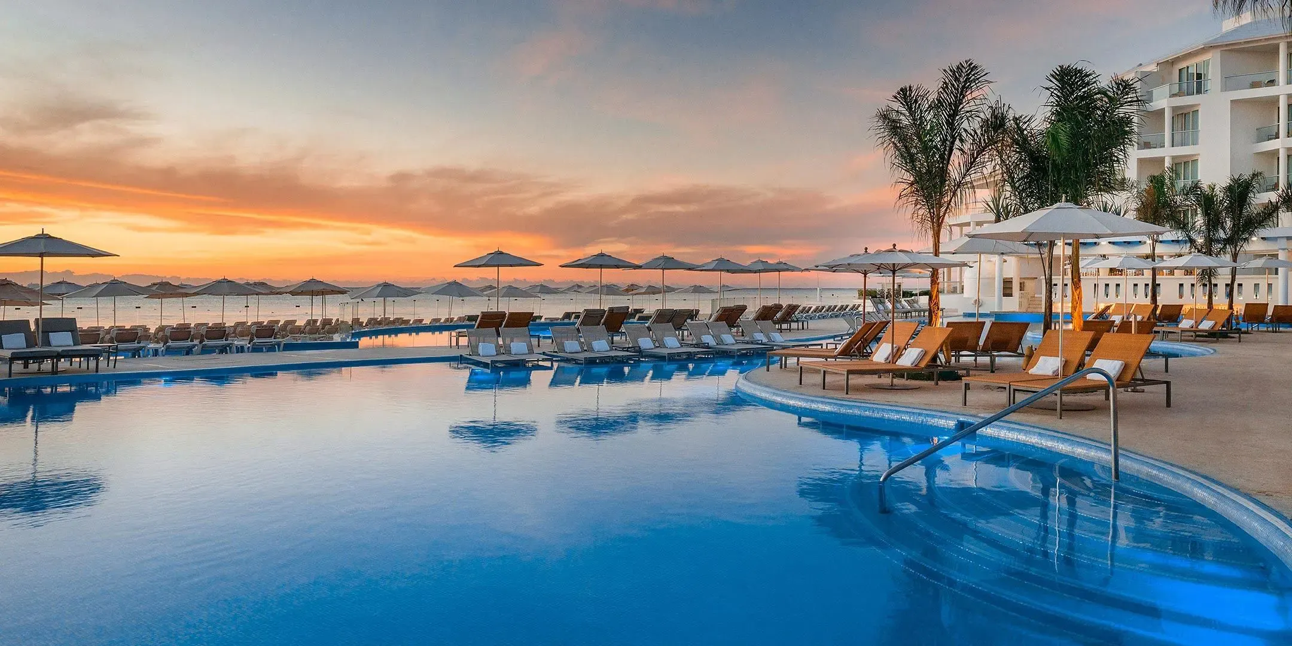
Our Main KPIs:
Total number of bookings
True check-in rate
True Cancellation rate
No-Show rate
Day-use rate
ADR
Average Lead time
ALOS
Total guests
Repeated guests
Customer Retention Rate
Market Segment Performance
Distribution Channel Performance

Slide 12
Other Unavailable KPIs in current data:
Occupancy Rate: The percentage of available rooms that are occupied during a specific period (day, week, month, year). It’-s a measure how well the hotel is utilizing its available rooms.
Revenue Per Available Room (RevPAR): A measure of a hotel's revenue-generating ability. It combines occupancy and ADR to provide a holistic view of revenue performance.
Customer Lifetime Value (CLTV): A prediction of the total revenue a customer is expected to generate during his relationship with the hotel to identify high-value customers and prioritize customer retention efforts.
Customer Satisfaction Score (CSAT) or Net Promoter Score (NPS): A measure of customer satisfaction and loyalty, typically collected through post-stay surveys, that Indicates the overall guest experience and identifies areas for improvement.

Slide 13
Research Questions for our Hotel Booking Data:
Overall Performance and Trends What are the overall booking trends for the hotel over the available time period? (e.g., How do total bookings vary by month and year?) What is the average daily rate (ADR) and how does it fluctuate over time? What is the average length of stay (ALOS) and how does it correlate with other variables? | Booking Characteristics: How does the number of booking changes relate to the length of stay, lead time, or cancellation rate? (Do bookings with more changes tend to be canceled more often?) What is the average number of special requests per booking, and how does this relate to customer satisfaction or loyalty? (High number might indicate dissatisfaction).
Cancellation Analysis: What is the overall cancellation rate, and what factors contribute to cancellations? Do cancellation rates vary significantly by market segment, distribution channel, or customer type? Is there a relationship between lead time and cancellation rate? (Do bookings made further in advance have a higher cancellation rate?) Does the deposit type (No Deposit vs. Refundable vs. Non-Refundable) affect the cancellation rate? Are there differences in cancellation behavior between repeated and non-repeated guests? How do previous cancellations influence future bookings? (Is there a higher likelihood of cancellation for guests with previous cancellations?) | Customer Segmentation: Which market segments generate the most bookings and revenue? Are there differences in ADR, ALOS, or cancellation rates across different market segments? What are the characteristics of repeat guests, and how do they differ from new guests? Which countries generate the most bookings, and their booking patterns?
 | Distribution Channel Effectiveness: Which distribution channels (e.g., direct, online TA, corporate) are most effective at driving bookings and revenue? Are there differences in ADR or cancellation rates across different distribution channels?
Pricing and Revenue Management How does ADR vary by month or market segment? Are there opportunities to optimize pricing based on demand patterns or customer segmentation? Does the number of days on the waiting list impact booking conversions or cancellation rates? | Operational Aspects Is there a discrepancy between reserved and assigned room types? If so, what impact does this have on customer satisfaction?

Slide 14

Data Visualization and dashboard:
Line charts for trend analysis: check-in and cancellation by month and year and correlation with ADR.
Bar charts for customer analysis.
Pie charts for customer classification.

Slide 15

Insights:
Although City Hotel had higher total bookings than Resort Hotel, yet City Hotel manifested lower performance than Resort (lower Check-in rate, Higher cancellation & No-show rates, shorter ALOS). This performance showed significant association with higher average ADR and average lead times than Resort.
PRT was the top check-in and top cancelling country for both hotels.
Week-end nights were least nights of stay for both hotels.
City tends to have steadier demand throughout the year apart from end of year (winter). Resort tends to have lower demand rates during summer, while higher during spring and autumn.
Both hotels’ check-in and cancellations were more related with No deposit types, new guests, Transient customer type, online TA market segment and TA/TO distribution channel collectively over the 3 years. In addition, the City Hotel showed higher cancellation rates with no-refund reservations in 2015, associated with high cancellations from transient party type. Both decreased down till 2017.
On the other hand, both hotels showed no significant relevance with other factors as previous cancellations, bookings changes, reserved room changes, length of waiting days nor number of special requests.
Least booking customers were of contract and group types, as well as direct market segment, repeated guests, refundable and no-refund deposit, representing points of actions for possible opportunities.

Slide 16

Areas of improvement:
Demand-based Opportunities | Action
High Demand Periods: | Dynamic pricing spikes during peak months Raise prices during peak seasons and lower them during off-peak periods to attract bookings.
Length of Stay (LOS) Resort guests stay longer than city hotel guests | Minimum LOS: Enforce minimum stay requirements during high-demand periods (e.g., festivals) to maximize occupancy. Discounts for Longer Stays: Encourage longer bookings during low-demand periods
Deposit/no refundable | Optimize Pricing: Offer discounts for non-refundable and refundable bookings to increase bookings.
Repeat Guests: Likely to pay more for personalized experiences. | Categorized pricing for loyal guests (e.g., VIP perks at higher rates).
Weekend vs. Weekday | Target higher rates for weekends
Corporate/Direct Bookings: | - Offer premium pricing for corporate guests with flexible dates (less price-sensitive) and loyalty rewards for direct bookings.

Slide 17
Areas of improvement:
Cancellation-based opportunities | Action
High-Risk Bookings: Guests with long lead times correlate with higher cancellations. | 1- Offer discounts for shorter lead times (e.g., last-minute bookings) to reduce cancellations and fill unsold rooms 2-Charge non-refundable deposits/discounts for long-lead bookings. 3-Offer discounts for flexible cancellation policies to retain uncertain guests
Market Segment Online Travel Agencies (OTAs): Higher cancellations | Charge higher OTA rates but offer discounts for non-refundable bookings to offset cancellation risks
Deposit/non refundable | -Regulations for no-deposit booking -Optimize Pricing: Offer discounts for non-refundable bookings to increase bookings and reduce cancellations (esp. for city)
Reduce No-show | Require deposits or credit card guarantees for new guests

Slide 18
Areas of improvement:
Customer Satisfaction | Use reviews or survey scores (if available) or infer satisfaction from behavioral data (e.g., cancellations, repeat bookings).
General | Compensation Policy: Offer discounts, upgrades, or loyalty points for discrepancies Adopt Predictive Tools: Integrate tools like (Market Insight) to forecast demand and adjust prices accordingly. A/B Test Pricing: Experiment with non-refundable vs. flexible rates for high-cancellation segments. Offer discounts for those on long waiting lists to reduce waiting list time and resolve overbooking: not applicable here because not an issue in our case. International bookings have higher cancellation rates: Dynamic pricing for international guests (e.g., non-refundable discounts).

Slide 19
Alternative resources:
Perplexity
ChatGPT
Perplexity
Adobe Color: https://color.adobe.com
Novypro: https://www.novypro.com/all_dashboards
References:
https://www.oracle.com/in/hospitality/what-is-hotel-pms/#:~:text=Traditionally%2C%20a%20hotel%20property%20management,managing%20room%20rates%2C%20and%20billing.
https://www.altexsoft.com/blog/hotel-property-management-systems-products-and-features/
https://engine.com/business-travel-guide/how-do-group-hotel-rates-work#:~:text=With%20almost%20every%20hotel%20the,agreed%20upon%20date%20or%20dates.
https://roompricegenie.com/transient-market-segment/#:~:text=Transient%20guests%20are%20one%20of,term%20stay%20in%20your%20facility.
https://insights.ehotelier.com/insights/2025/01/23/assessing-group-and-transient-bookings-which-is-better-for-your-hotel/#:~:text=Transient%20bookings%20offer%20flexibility%2C%20high,and%20long%2Dterm%20revenue%20visibility.
https://www.mews.com/en/blog/direct-bookings-vs-third-party reservations#:~:text=Third%20party%20hotel%20bookings%20are,and%20guests%20to%20book%20conveniently.
https://www.fourseasons.com/sharmelsheikh/

Slide 20
Thank you

